Slide 1
Flask 페이지 설계
지우연

Slide 2
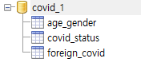
DataBase 설계(테이블)
age_gender: 연령별, 성별 코로나 현황
covid_status: 광역시도별 코로나 현황
foreign_covid: 코로나 해외 현황

Slide 3
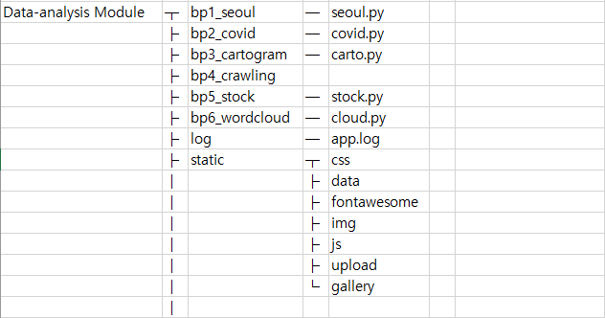
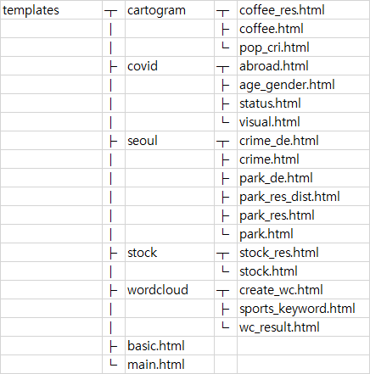
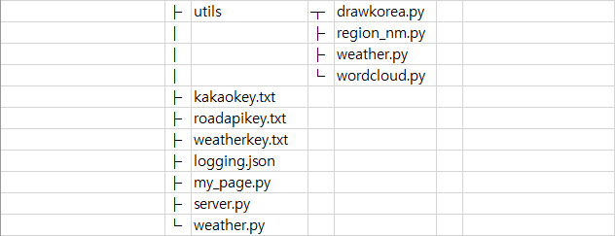
파일 구조

Slide 4
Routing - 메인
path | detail path | method | client -> server parameter | html파일 | server -> html params | 다음 행선지
/ |  | get |  |  |  | /main
/main |  | get |  |  | menu, weather | /seoul, /covid, /crawl, /stock, /carto, /cloud

Slide 5
Routing - /seoul
path | detail path | method | client -> server parameter | html파일 | server -> html params | 다음 행선지
/seoul |  |  |  |  |  | /seoul/park /seoul/park_de/area /seoul/crime /seoul/cctv
/seoul/park |  | get |  | park.html | menu, weather, park_list, dist_list, mtime | park_res.html park_res_dist.html
 |  | post | distinct, name/dist | park_res.html park_res_dist.html | menu, weather, park_result/ dist_result, mtime
/seoul/park_de | /area | get | option | park_de.html | menu, weather, option, option_dict, mtime
 | /count
 | /area_ratio
 | /per_person

Slide 6
Routing - /seoul
path | detail path | method | client -> server parameter | html파일 | server -> html params | 다음 행선지
/seoul/crime |  |  |  |  |  | /crime_de/violence, /crime_de/rape, /crime_de/theft, /crime_de/robbery, /crime_de/murder, /crime_de/violence_arr, /crime_de/rape_arr, /crime_de/theft_arr, /crime_de/robbery_arr, /crime_de/murder_arr
/seoul/crime_de | /violence | get | option | crime_de.html | menu, weather, option, option_dict1, option_dict2, column_index, mtime
 | /rape
 | /theft
 | /robbery
 | /murder
 | /violence_arr | post
 | /rape_arr
 | /theft_arr
 | /robbery_arr
 | /murder_arr

Slide 7
Routing - /covid
path | detail path | method | client -> server parameter | html파일 | server -> html params | 다음 행선지
/covid |  |  |  |  |  | /covid/national_status, /covid/age_gender, /covid/abroad, /covid/visual
/covid/national_status |  | get |  | status.html | menu, weather, rows, date | /covid/update_status
/covid/update_status | <date> | get | date
/covid/age_gender |  | get |  | age_gender.html | menu, weather, rows, date | /covid/update_age_gender
/covid/update_age_gender | <date> | get | date
/covid/abroad |  | get |  | abroad.html | menu, weather, rows, date | /covid/update_abroad
/covid/update_abroad | <date> | get | date
/covid/visual |  | get |  | visual.html | menu, weather, mtime, regions | visual_res.html
 |  | post | district | visual_res.html | menu, weather, mtime

Slide 8
Routing - /carto
path | detail path | method | client -> server parameter | html파일 | server -> html params | 다음 행선지
/carto |  |  |  |  |  | /carto/pop_crisis, /carto/coffee
/carto/pop_crisis | /crisis_area | get | option | pop_cri.html | menu, weather, mtime, option, columns
 | /crisis_ratio
/carto/coffee |  | get |  | coffee.html | menu, weather | coffee_res.html
/covid/update_age_g | <date> | post | carto_list, csv | coffee_res.html | menu, weather, carto, mtime, top10

Slide 9
Routing - /cloud
path | detail path | method | client -> server parameter | html파일 | server -> html params | 다음 행선지
/cloud |  |  |  |  |  | /cloud/create_wc, /cloud/sports_keyword
/cloud/create_wc |  | get |  | create_wc.html | menu, weather | wc_result.html
 | /crisis_ratio | post | lang, txt, mask, stopwords | wc_result.html | menu, weather, mtime
/cloud/sports_keyword |  | get |  | sports_keyword.html | menu, weather, mtime

Slide 10
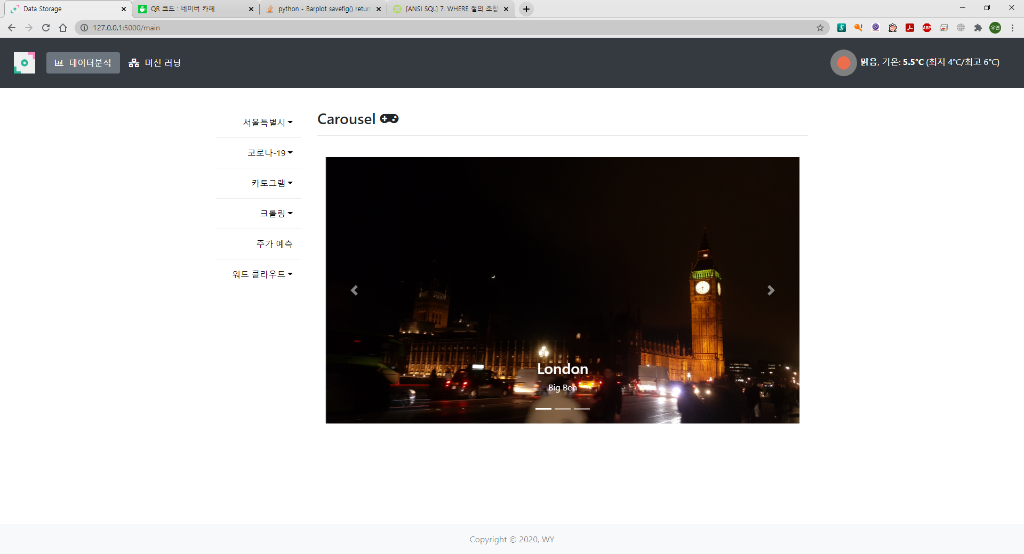
main 화면

Slide 11
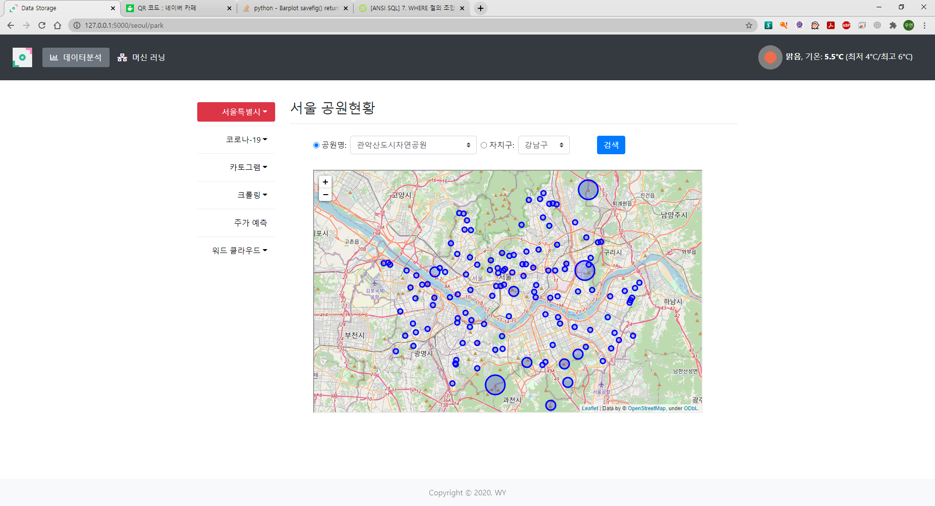

Slide 12
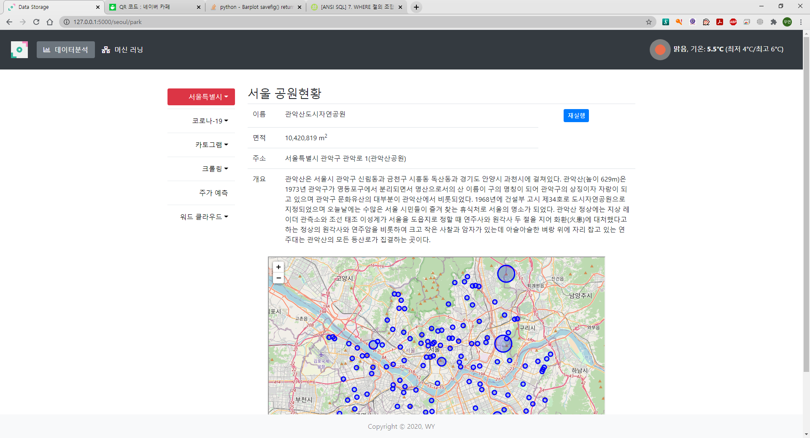
공원 정보 입력 후

Slide 13
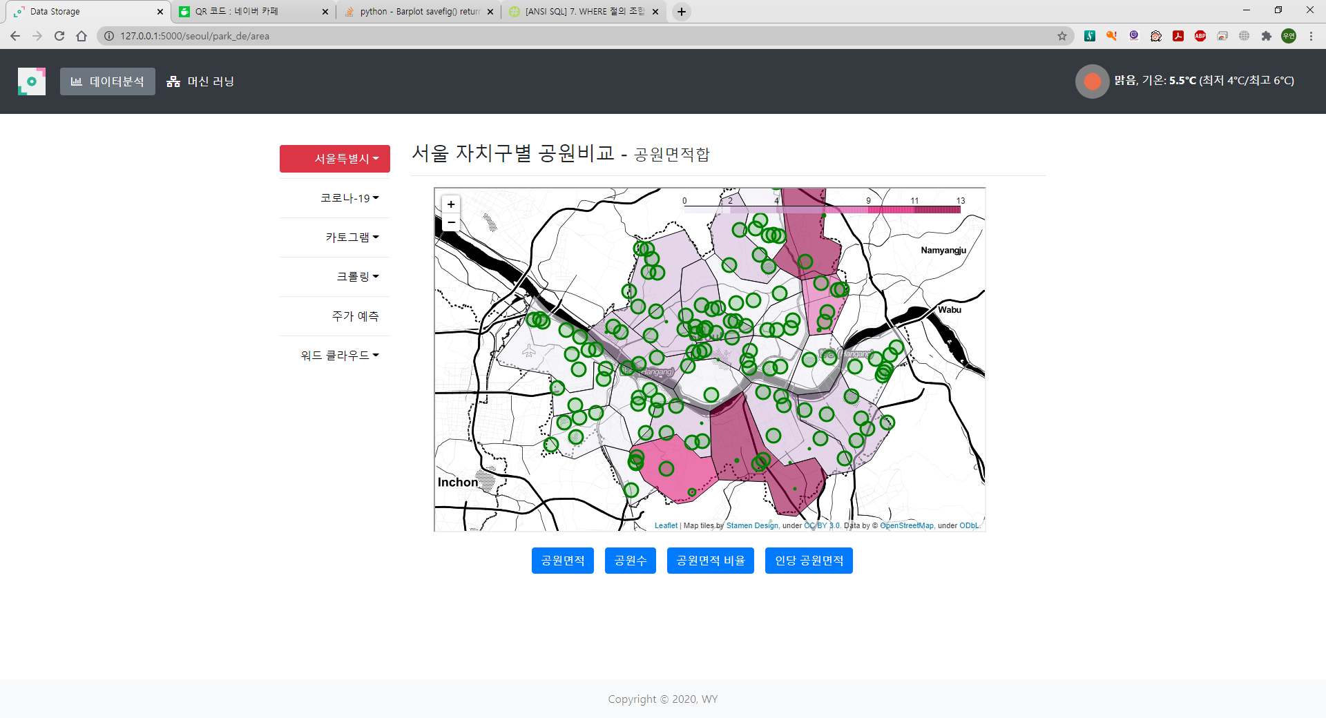

Slide 14
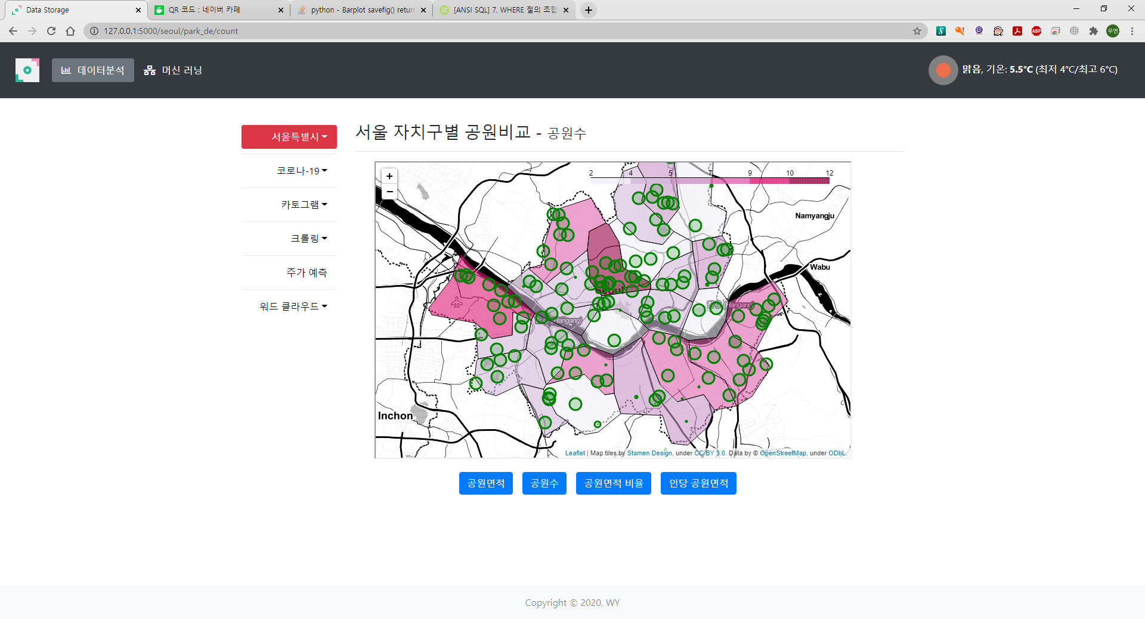

Slide 15
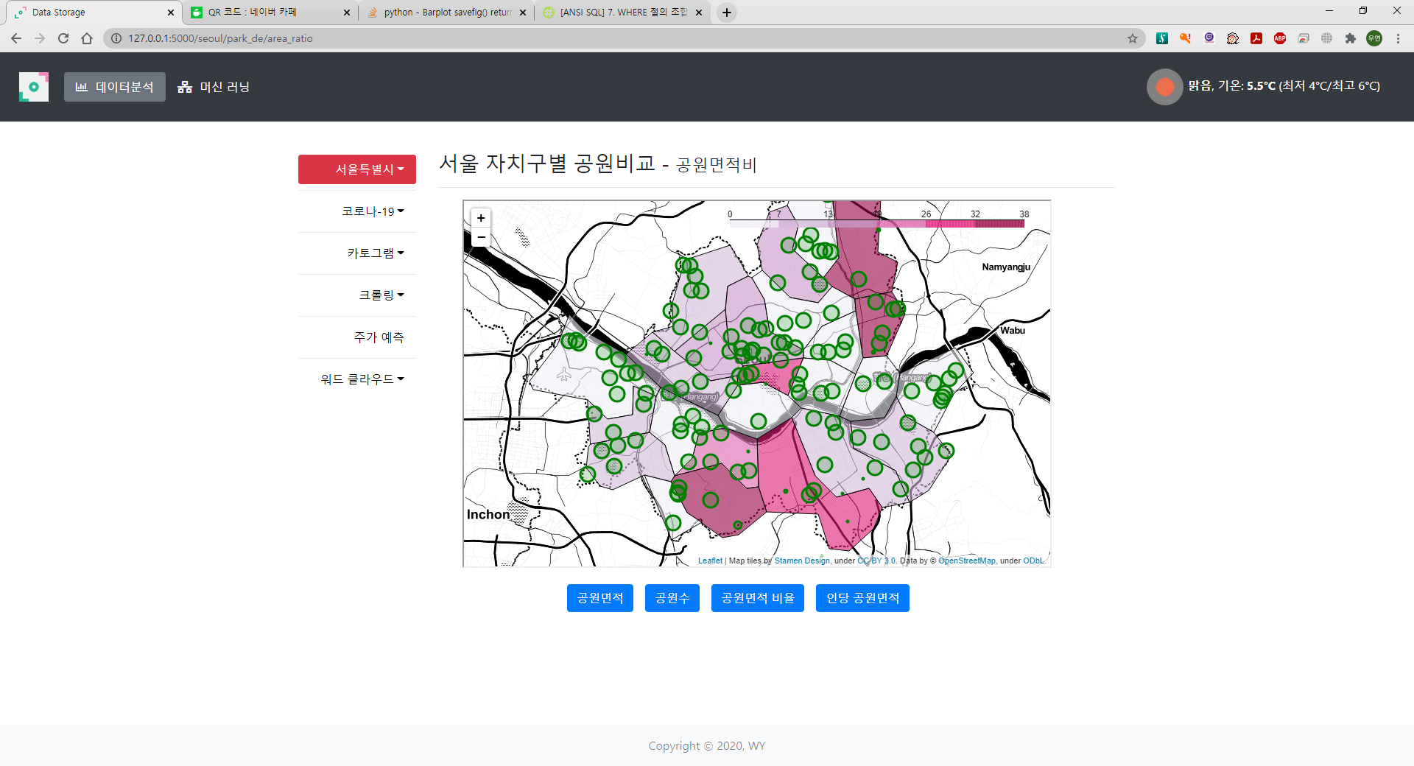

Slide 16
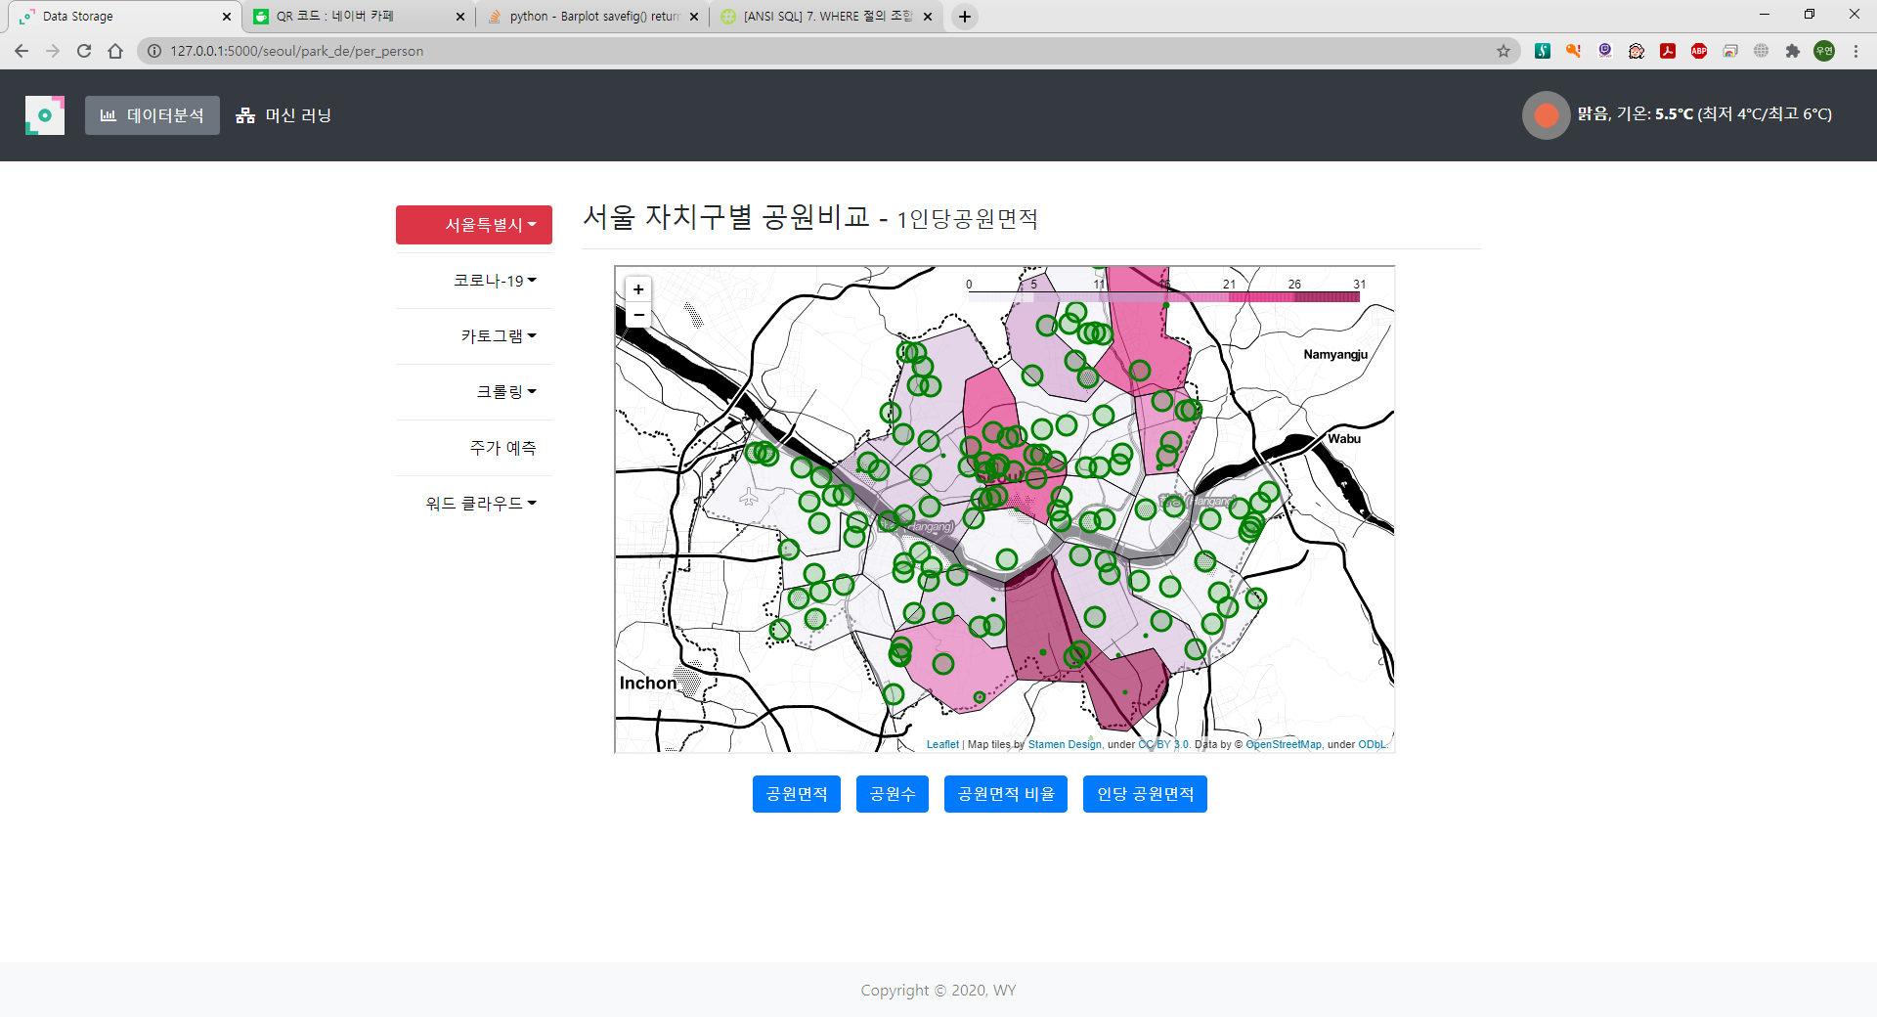

Slide 17
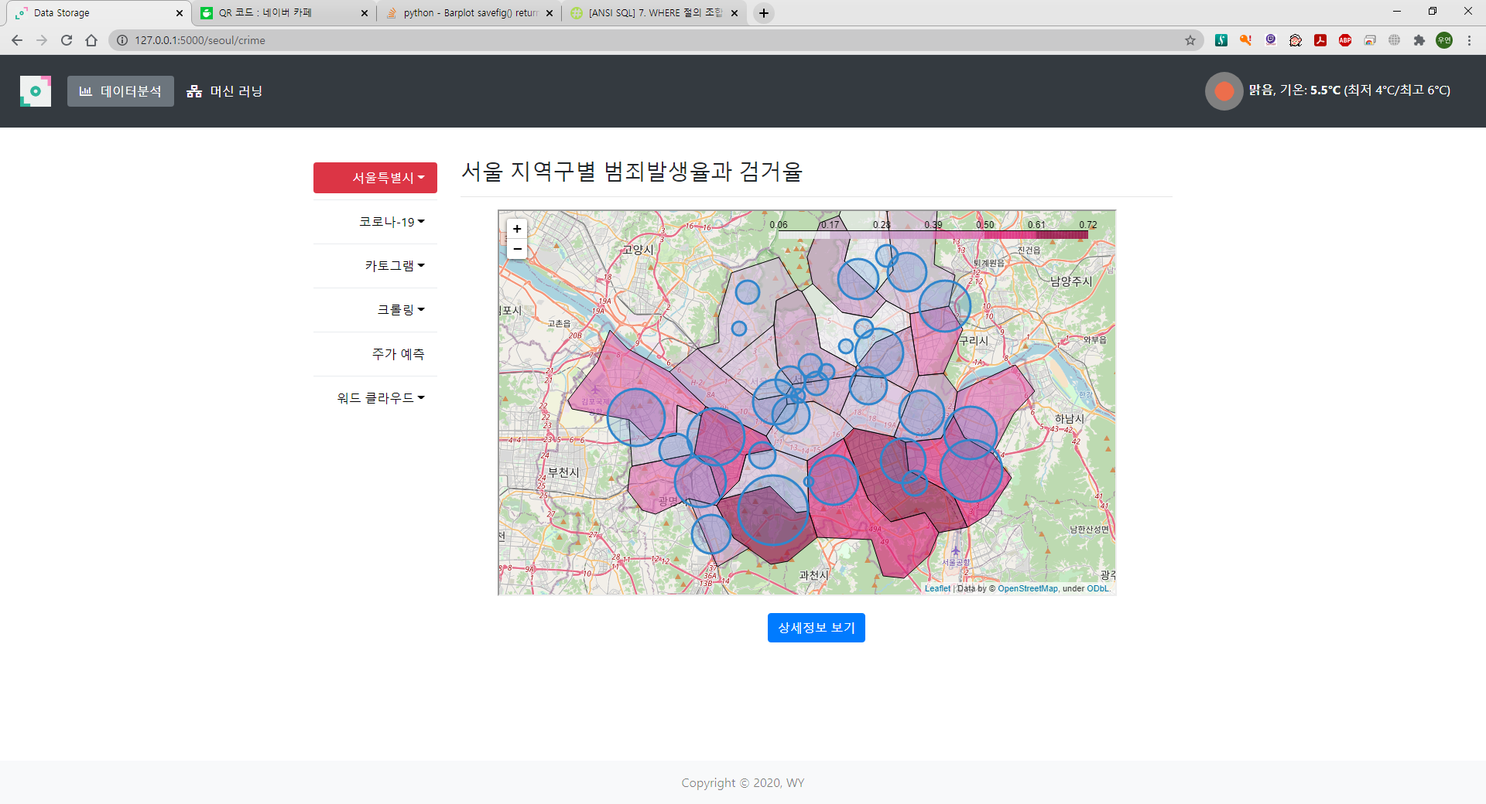

Slide 18
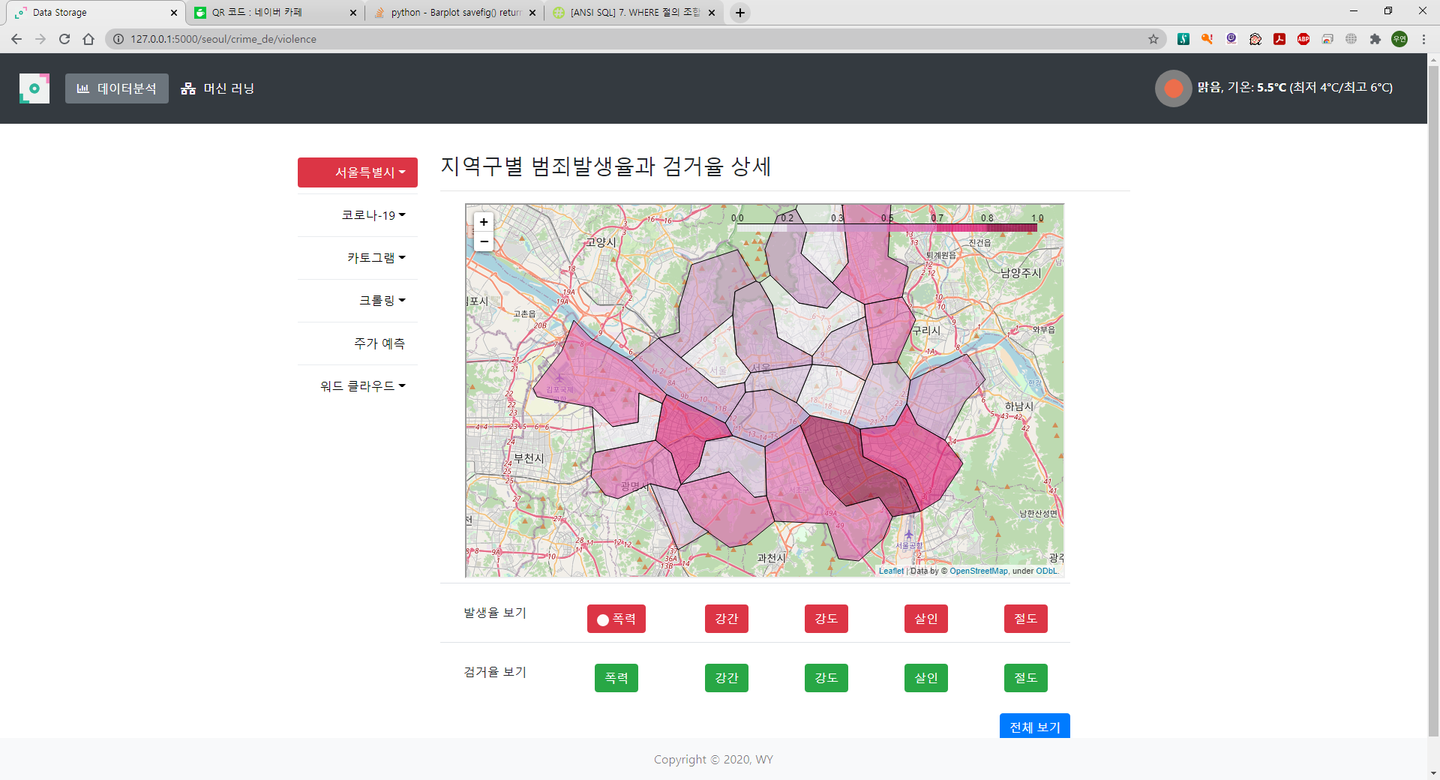
상세 보기 클릭 후

Slide 19
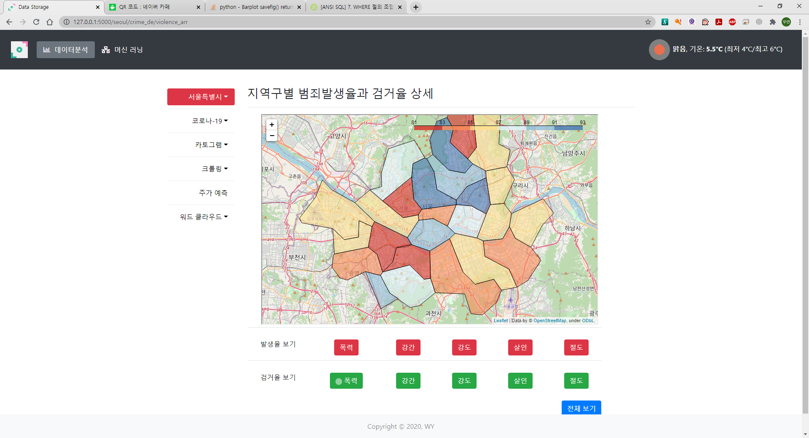
검거율 화면

Slide 20
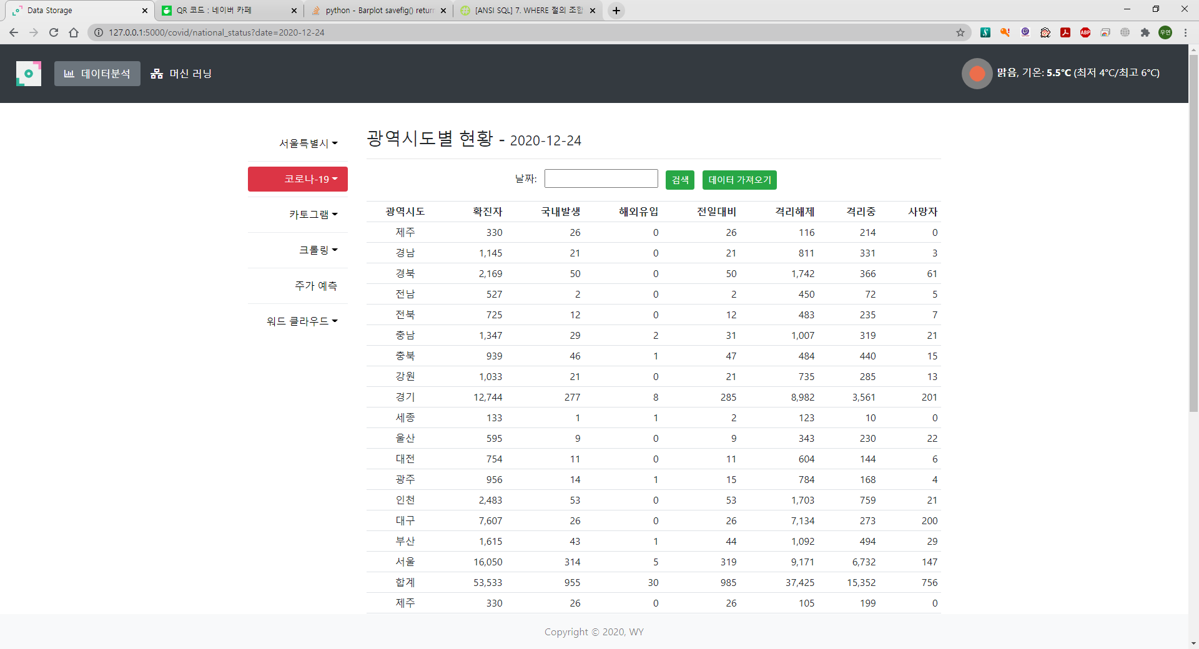

Slide 21
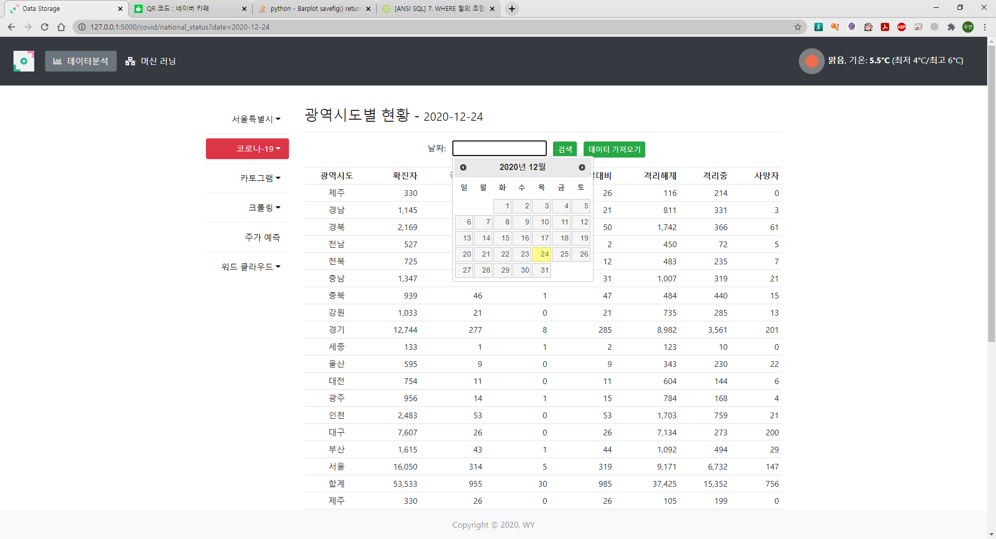
날짜 선택

Slide 22
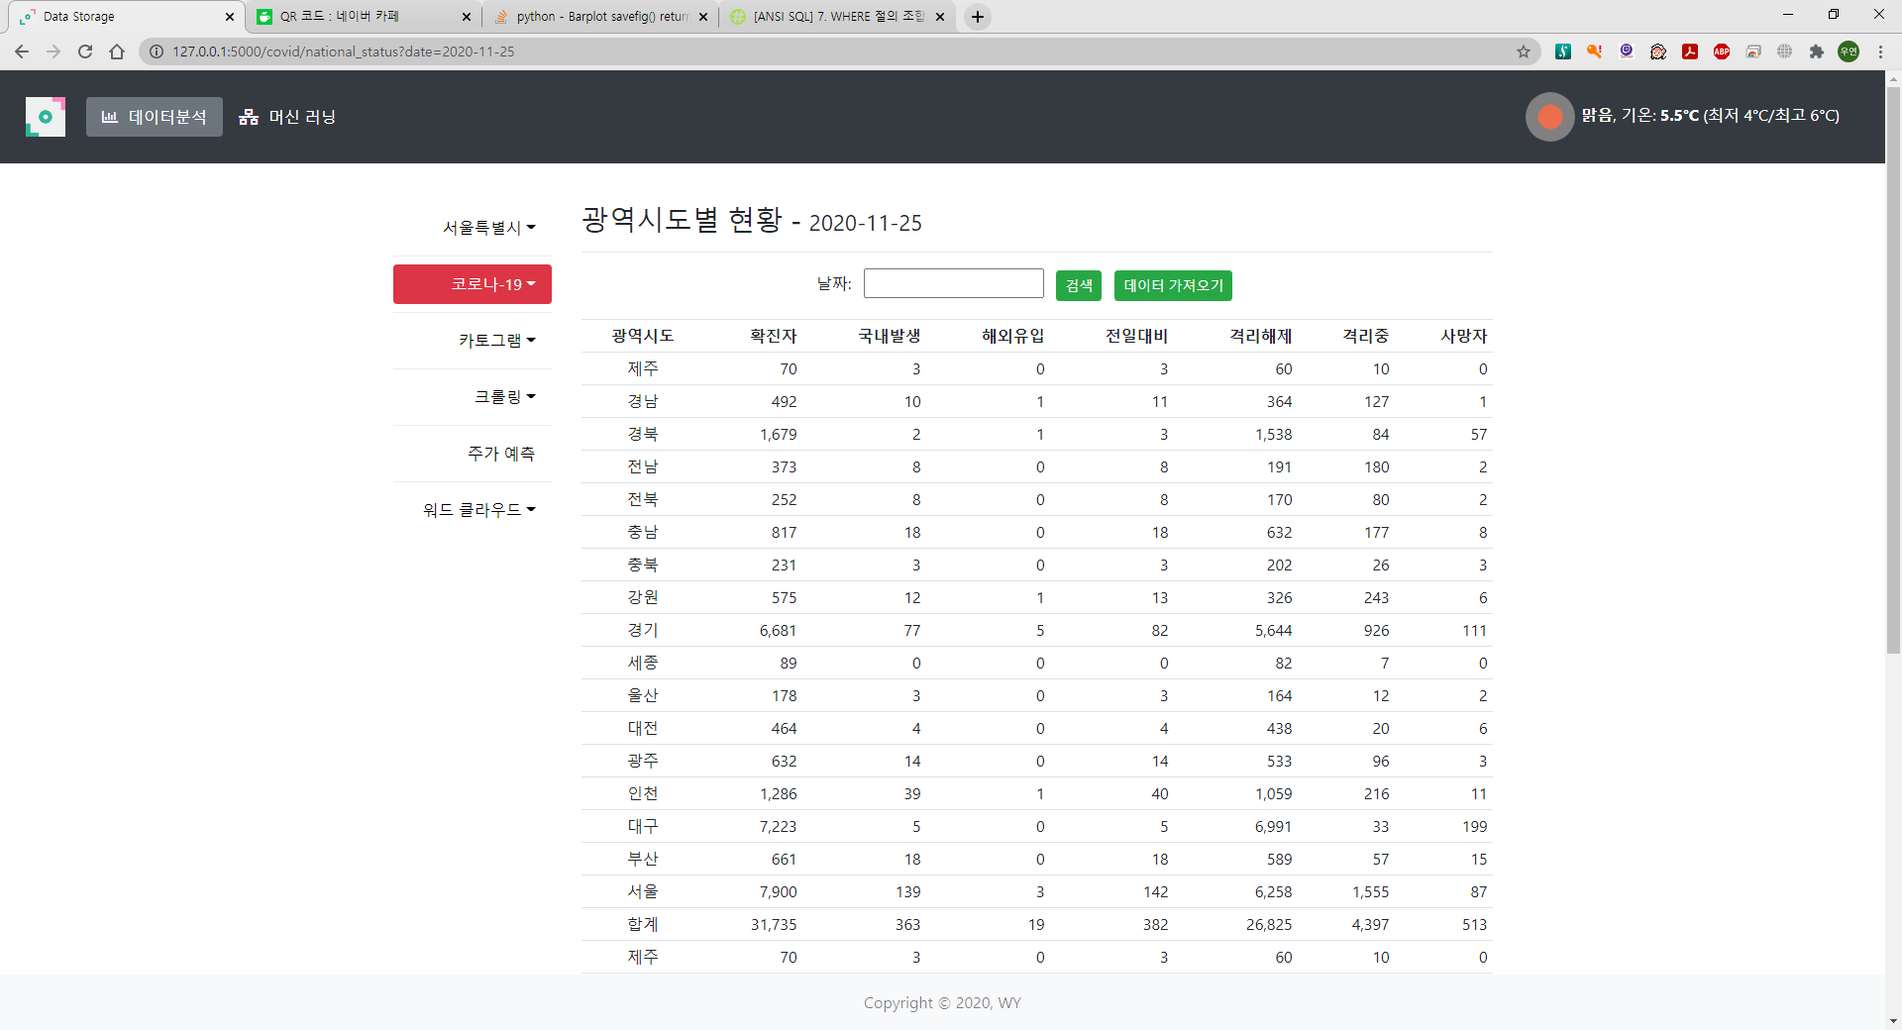

Slide 23
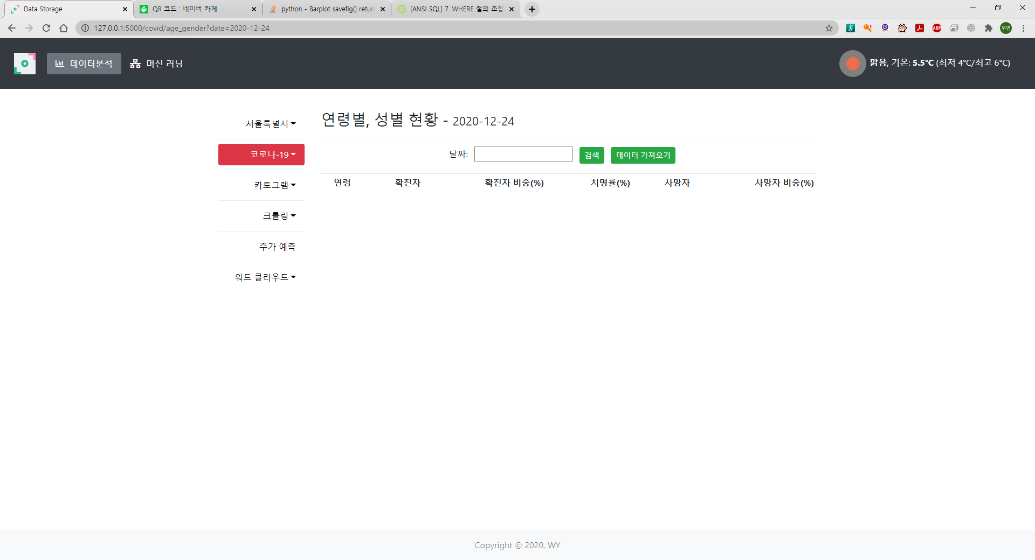

Slide 24
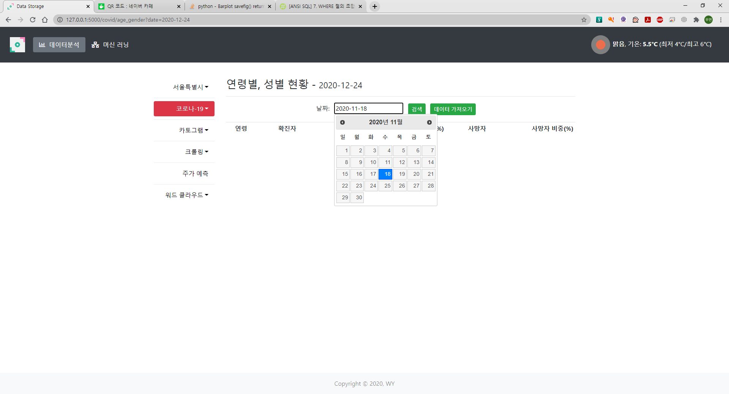
날짜 선택

Slide 25
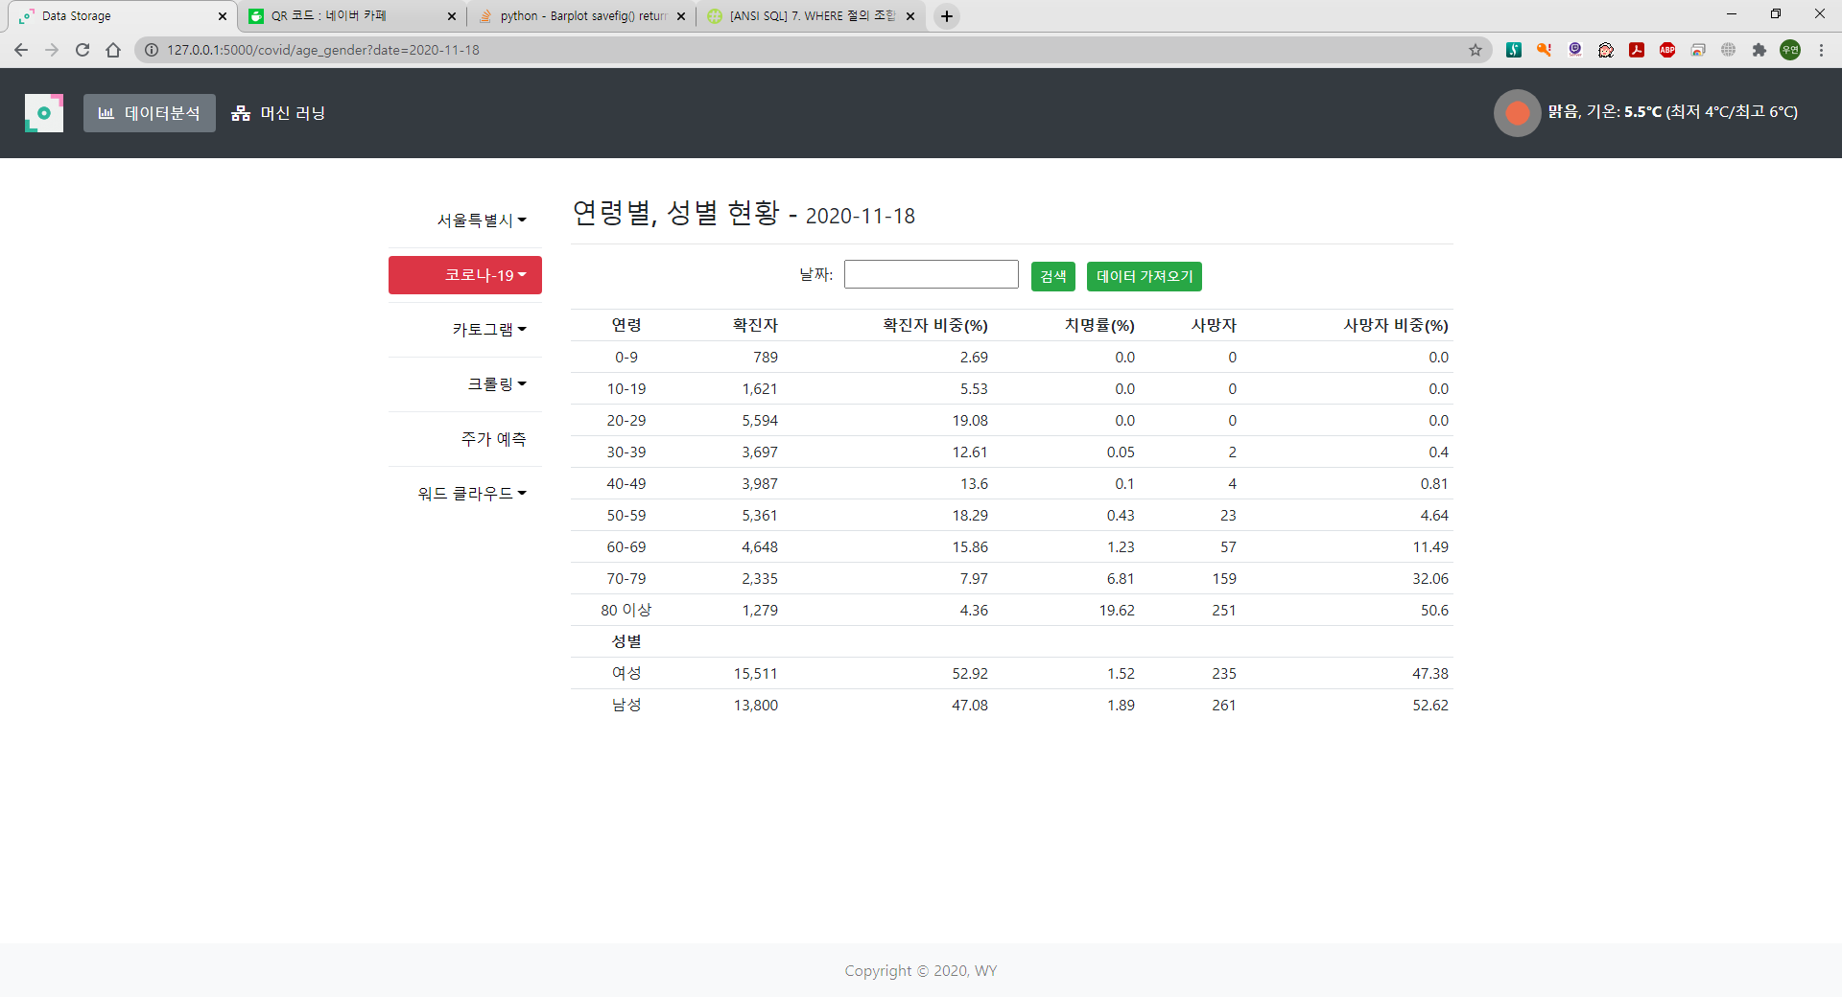

Slide 26
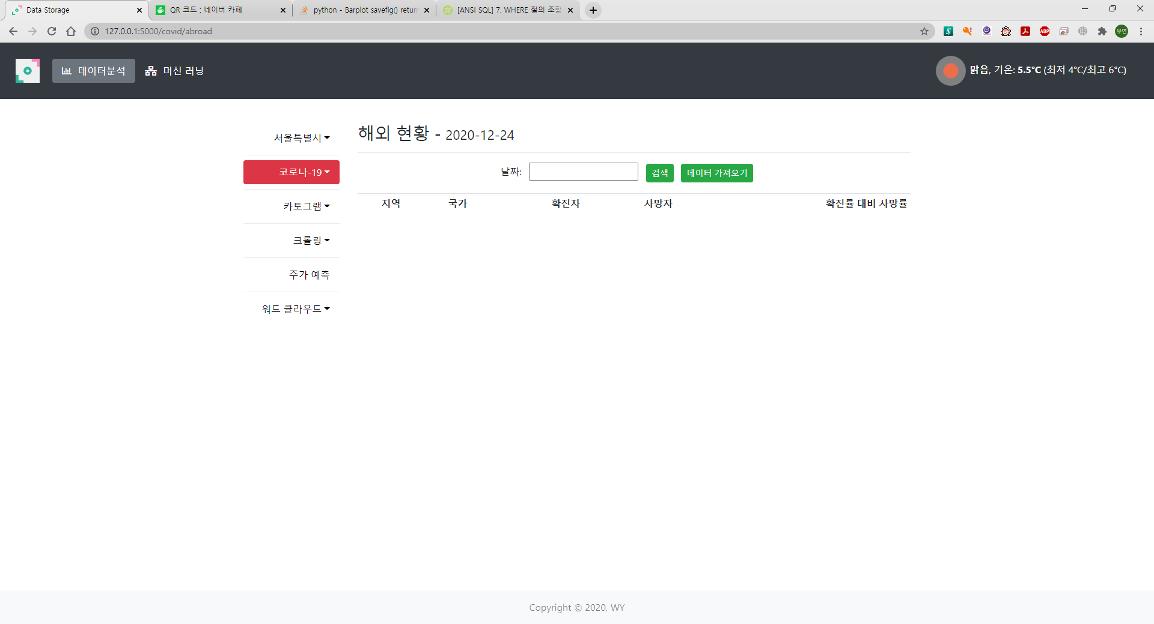

Slide 27
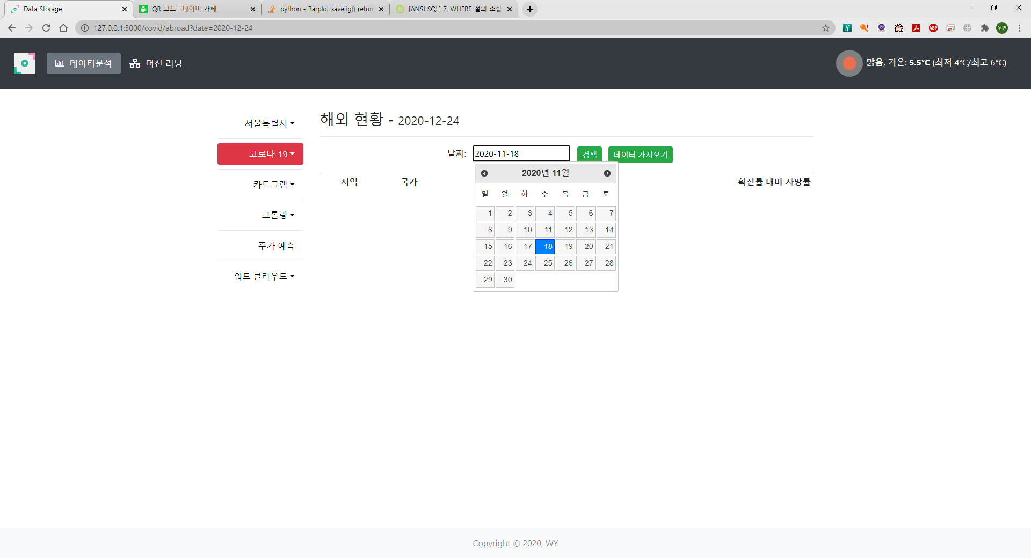
날짜 선택

Slide 28
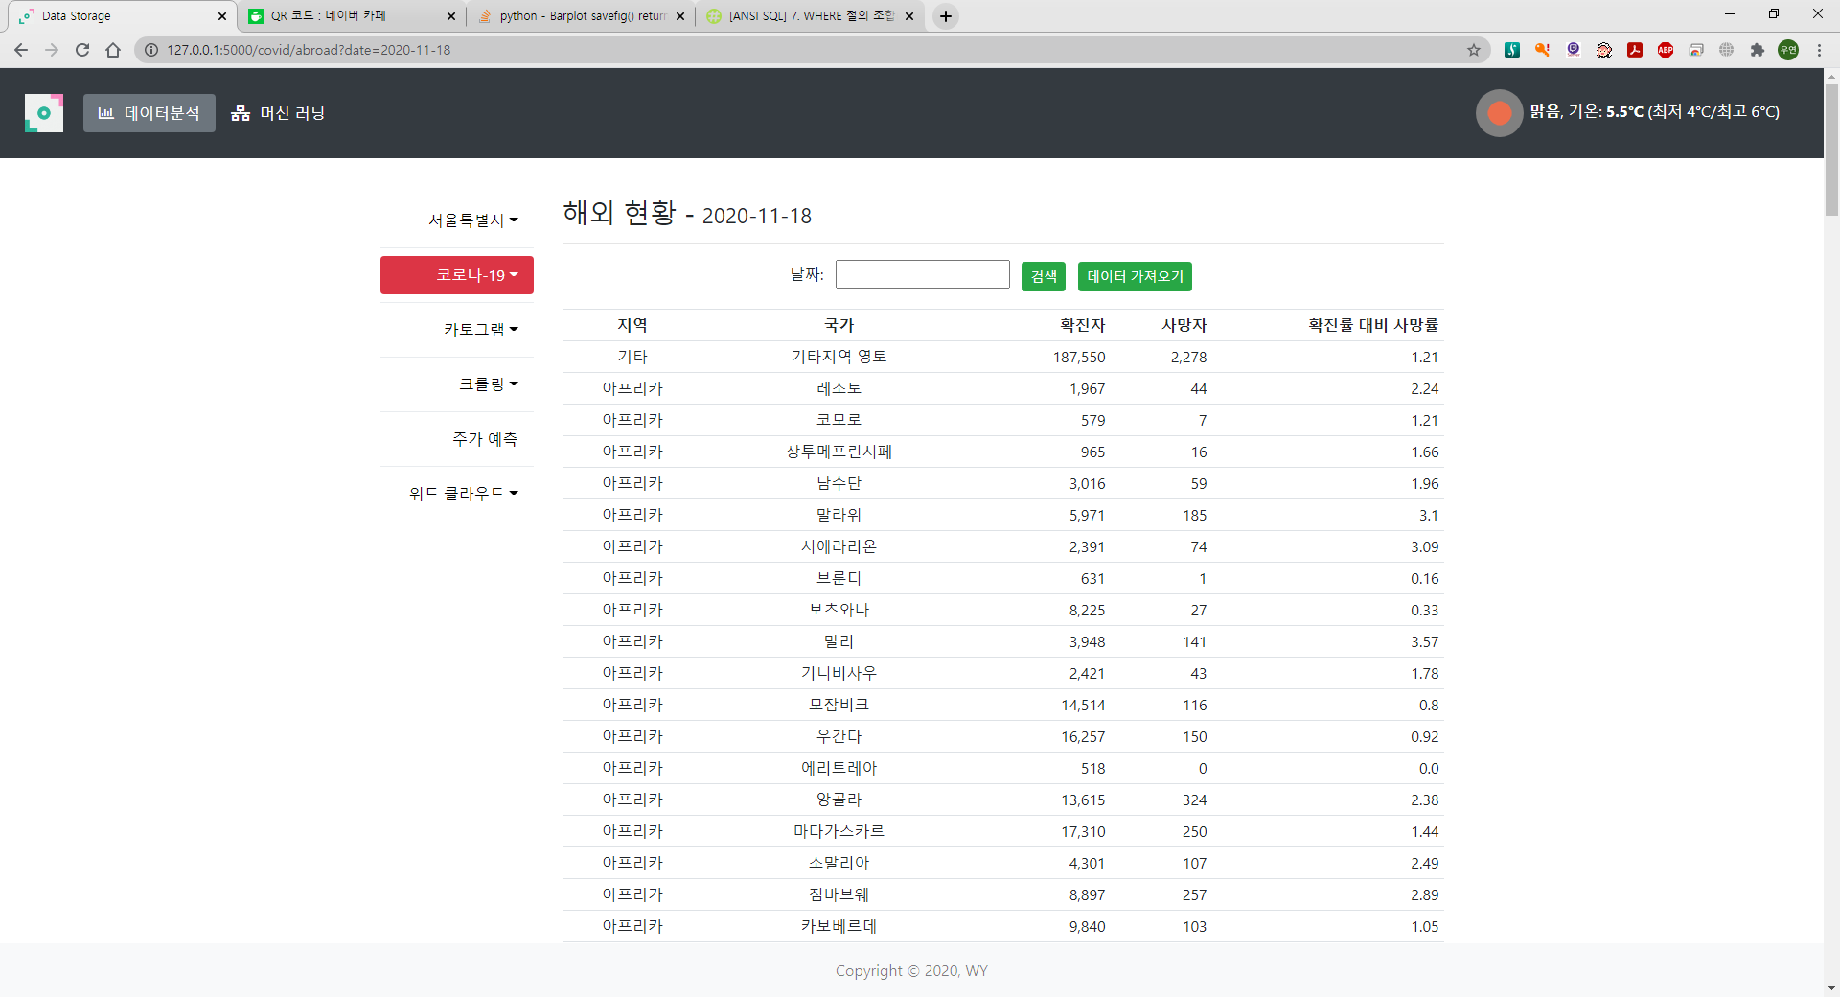

Slide 29
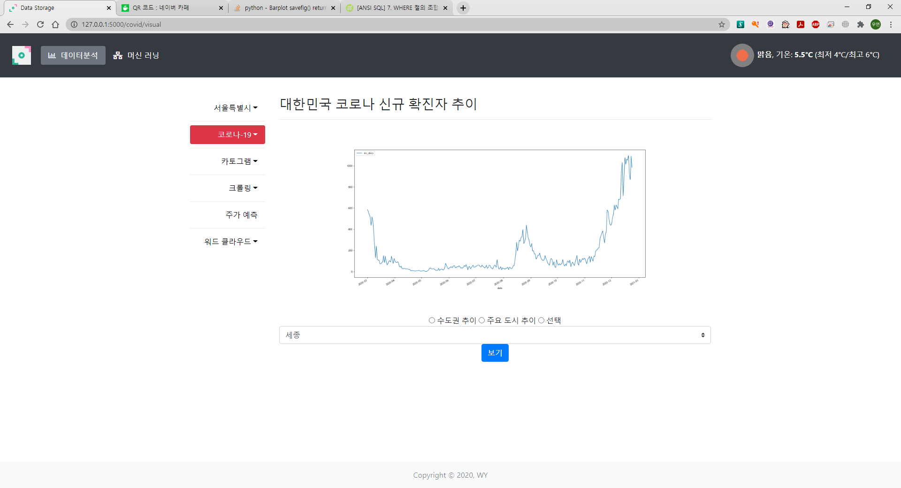
(미완성)

Slide 30
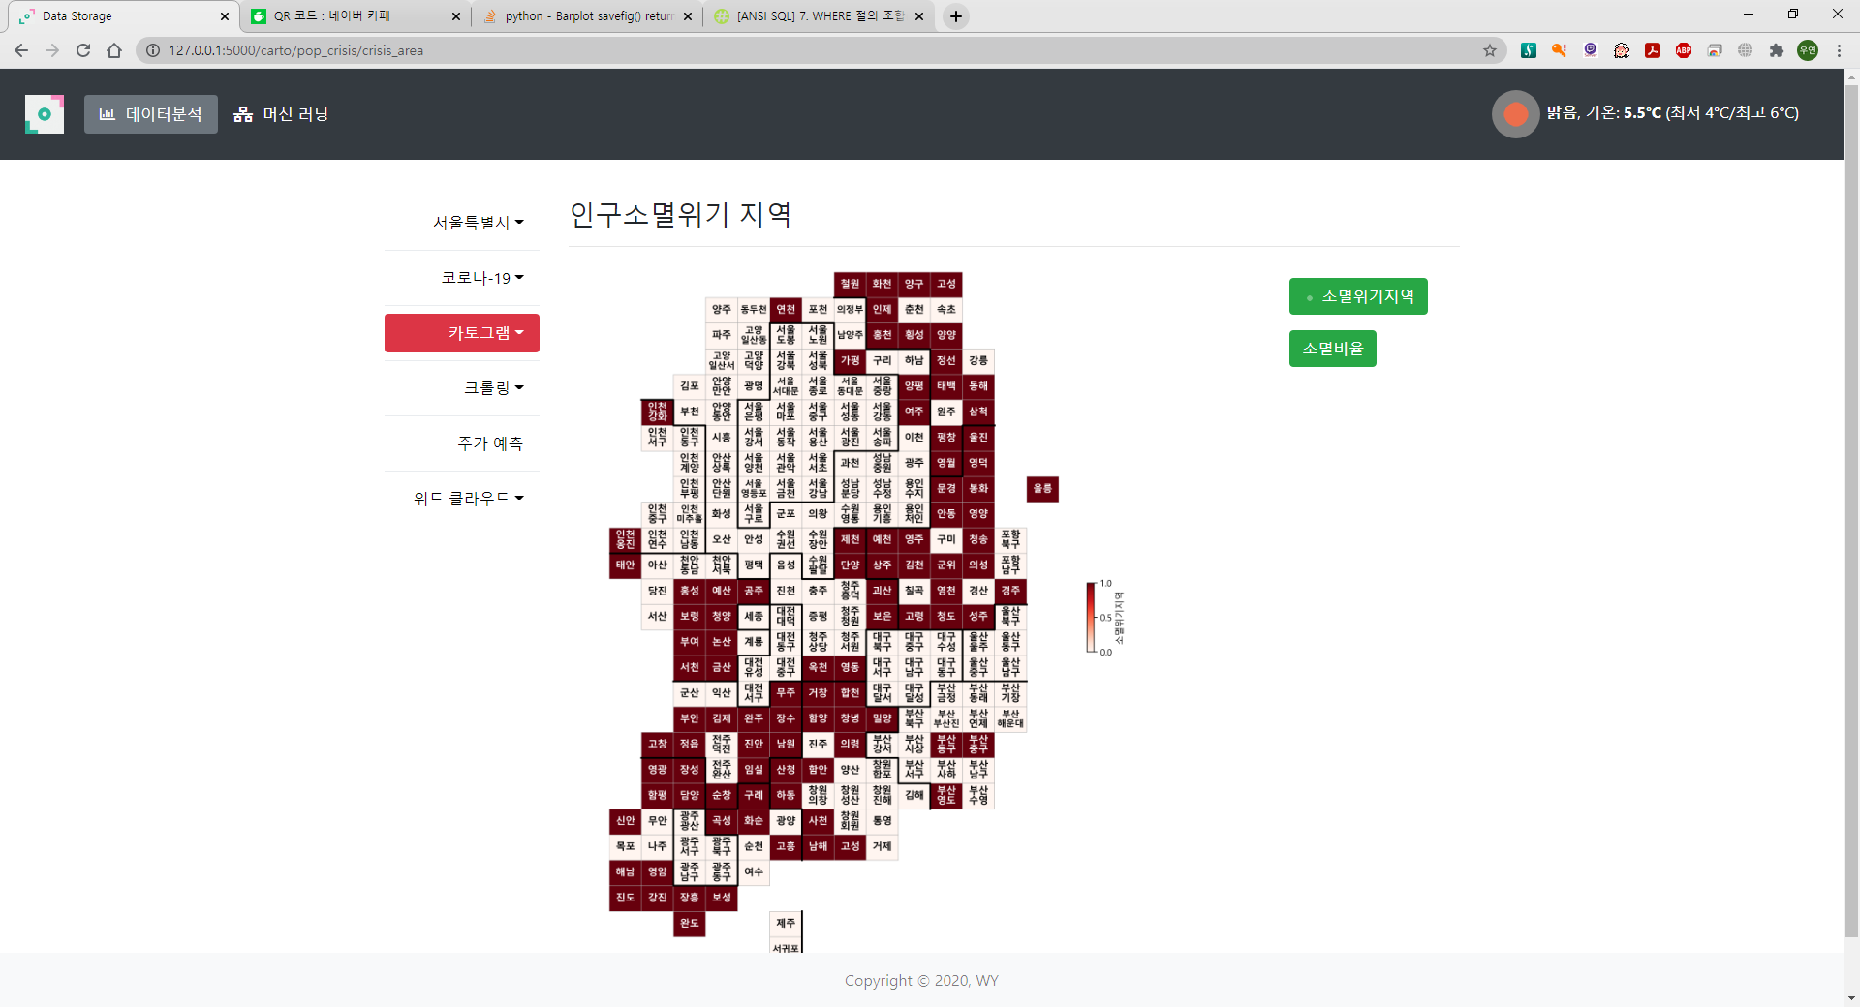

Slide 31
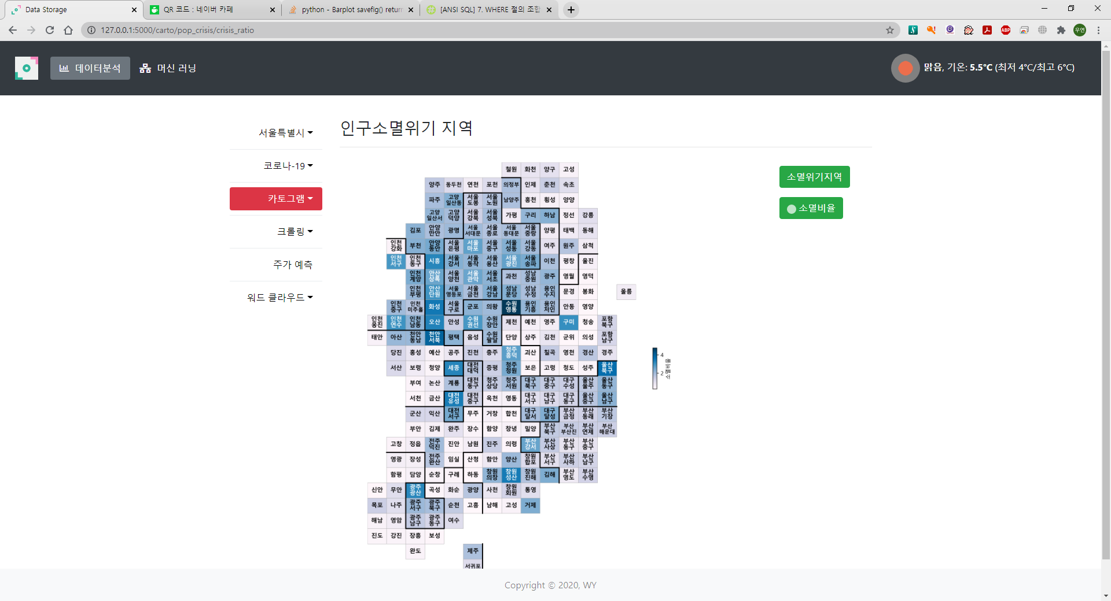

Slide 32
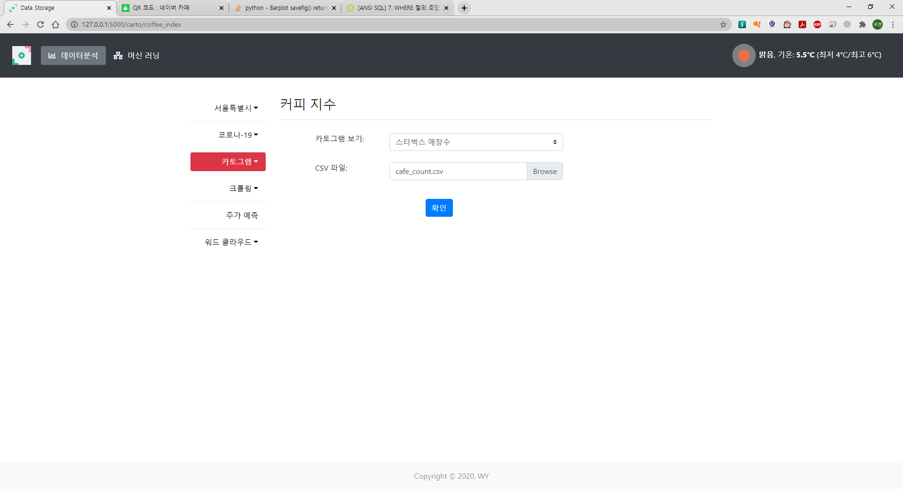

Slide 33
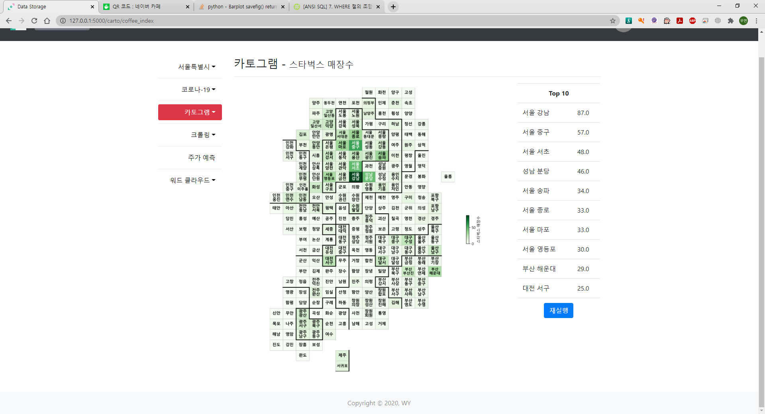

Slide 34
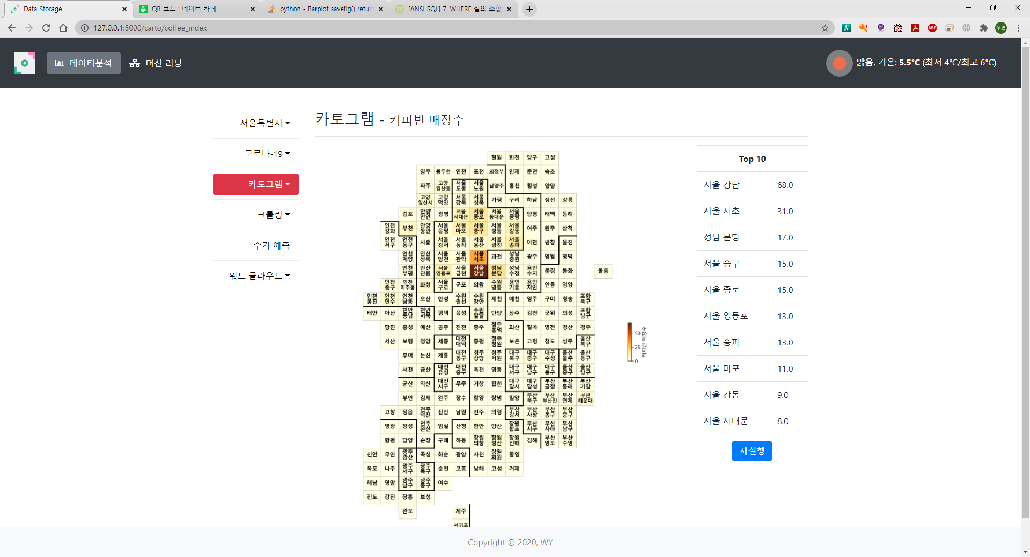

Slide 35
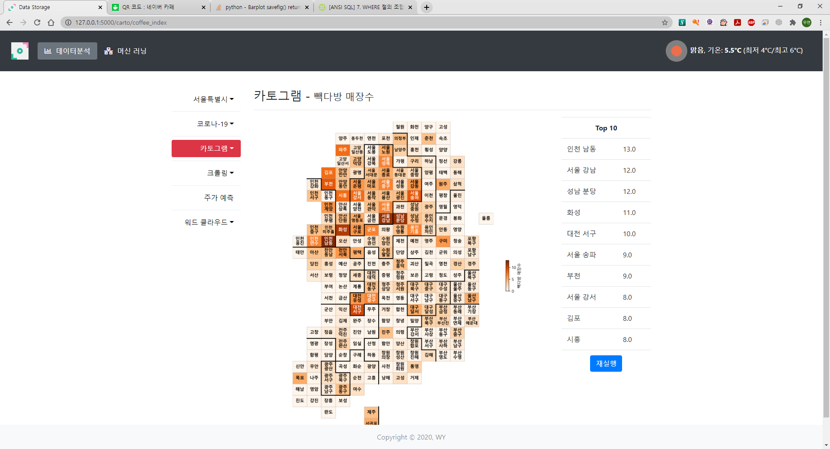

Slide 36
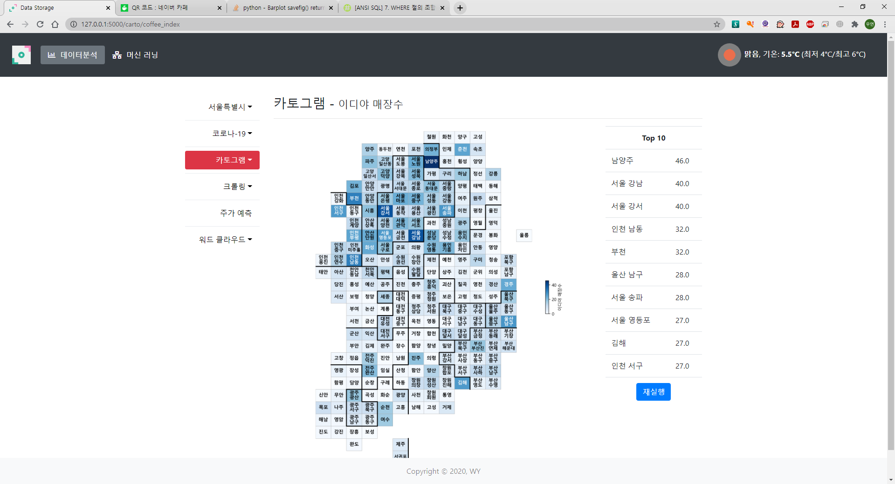

Slide 37
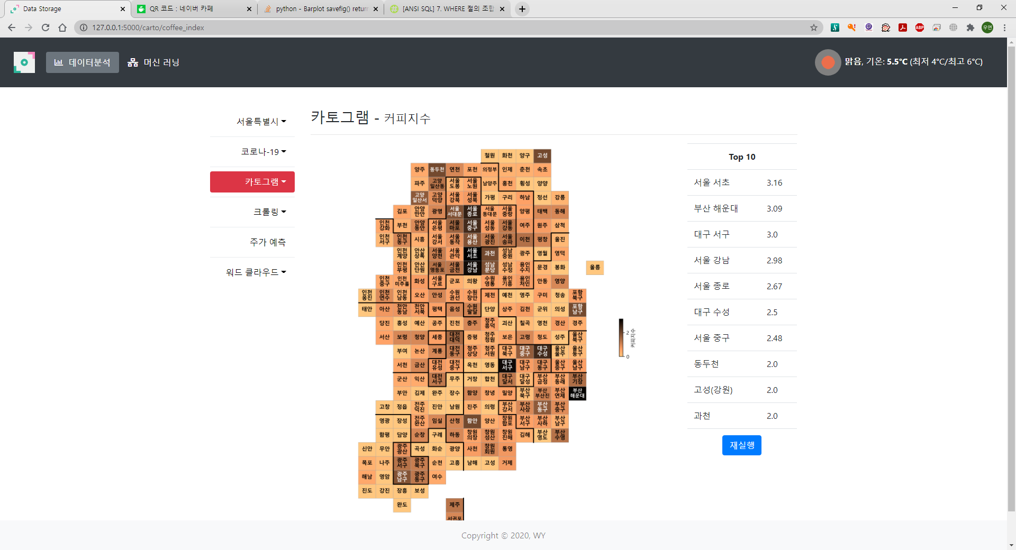

Slide 38
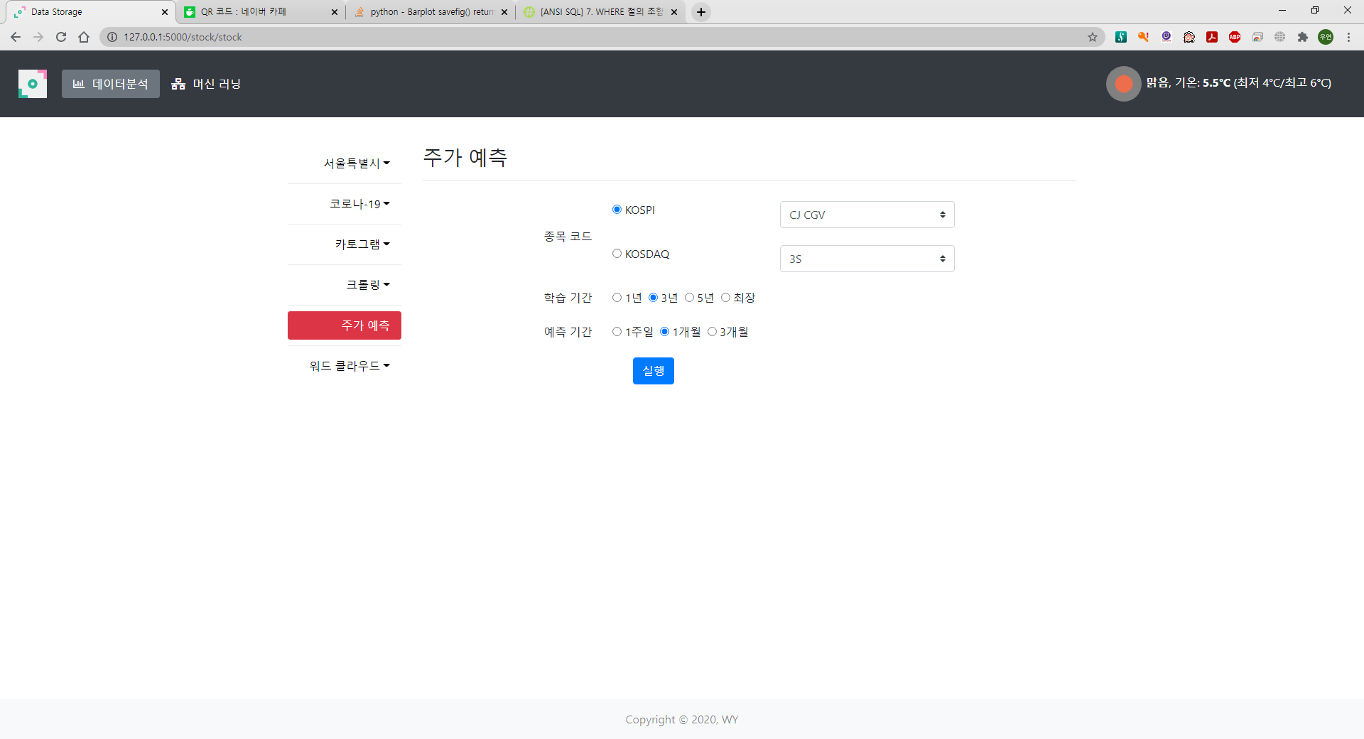

Slide 39
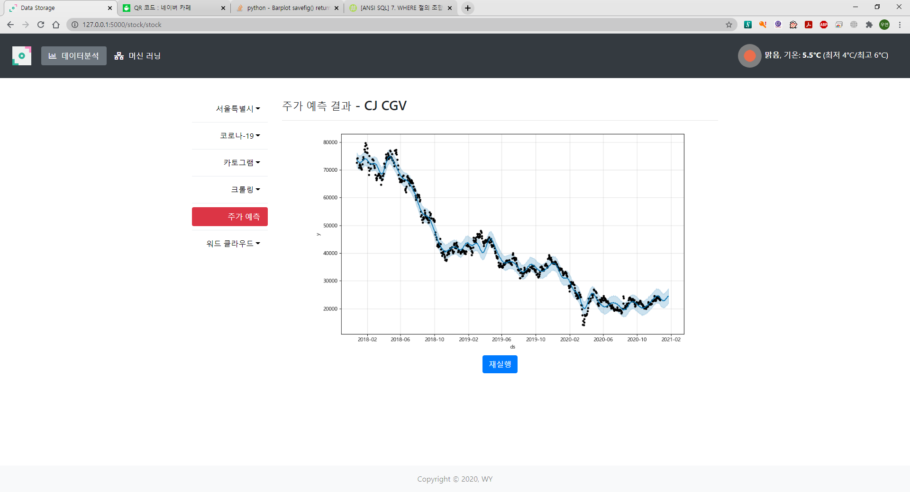

Slide 40


Slide 41
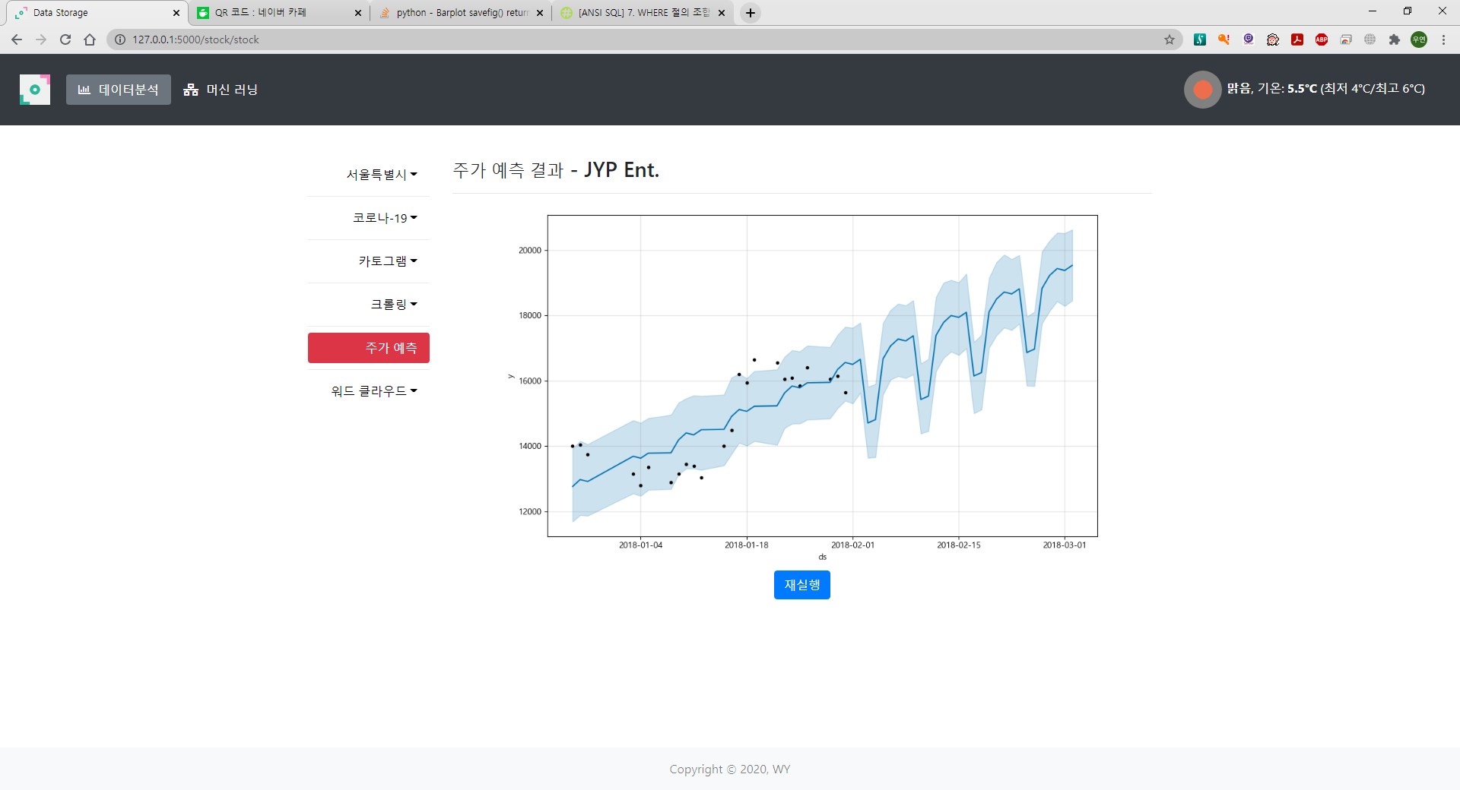

Slide 42
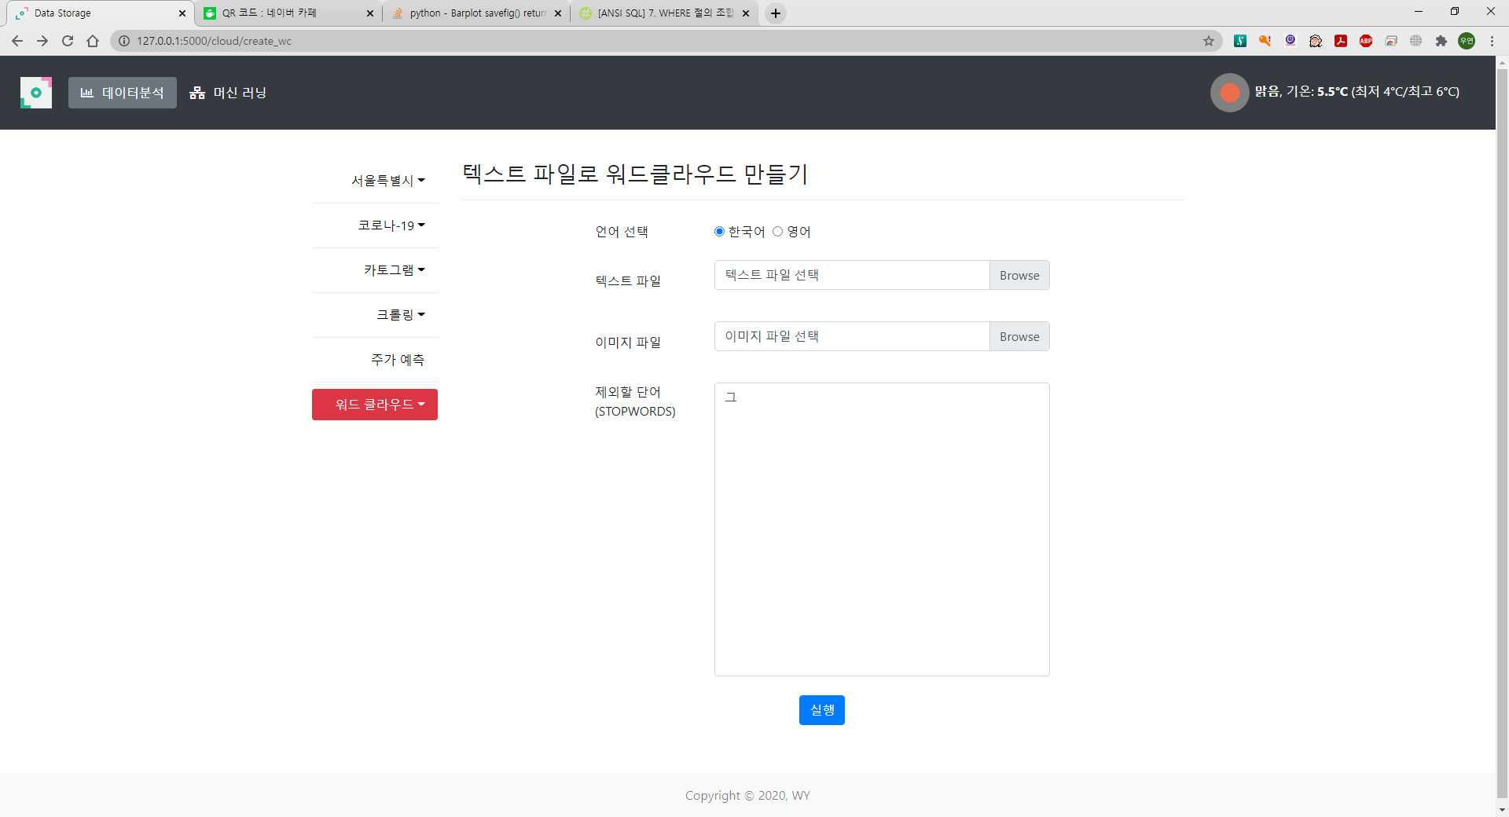

Slide 43
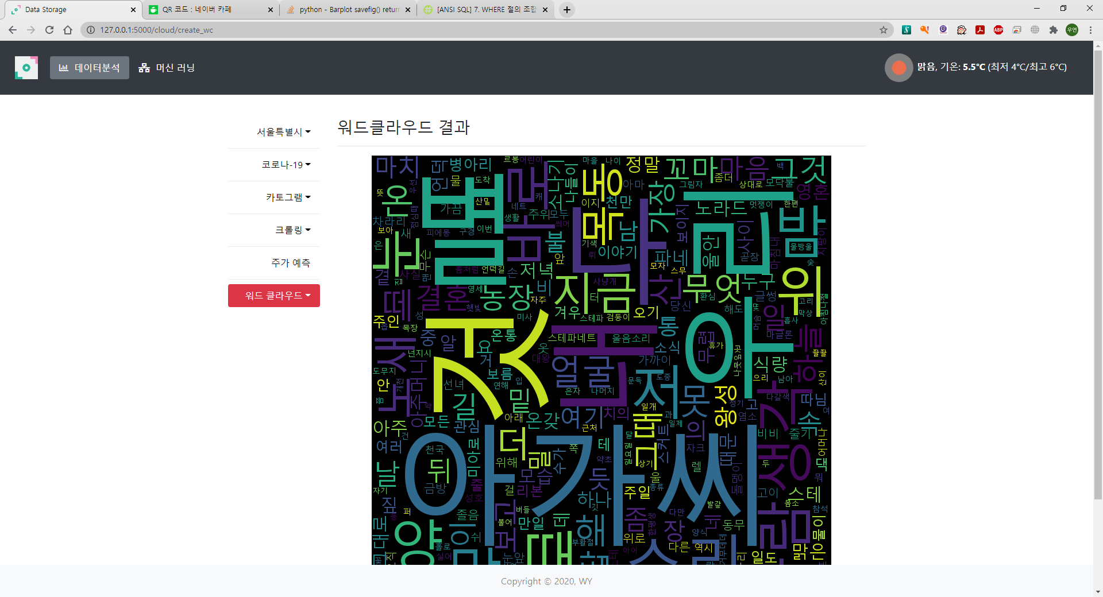

Slide 44


Slide 45
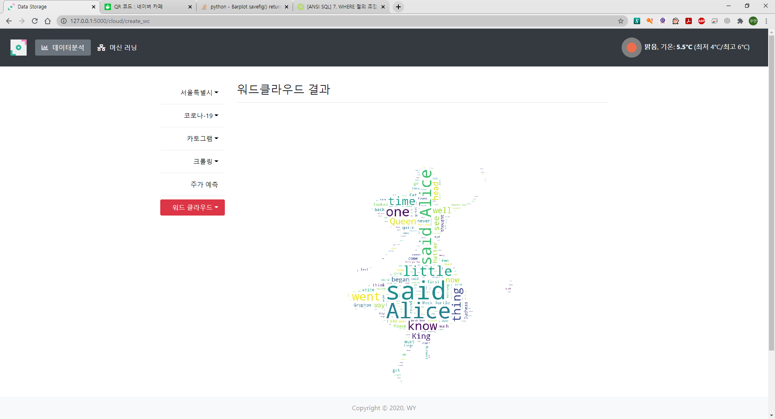

Slide 46
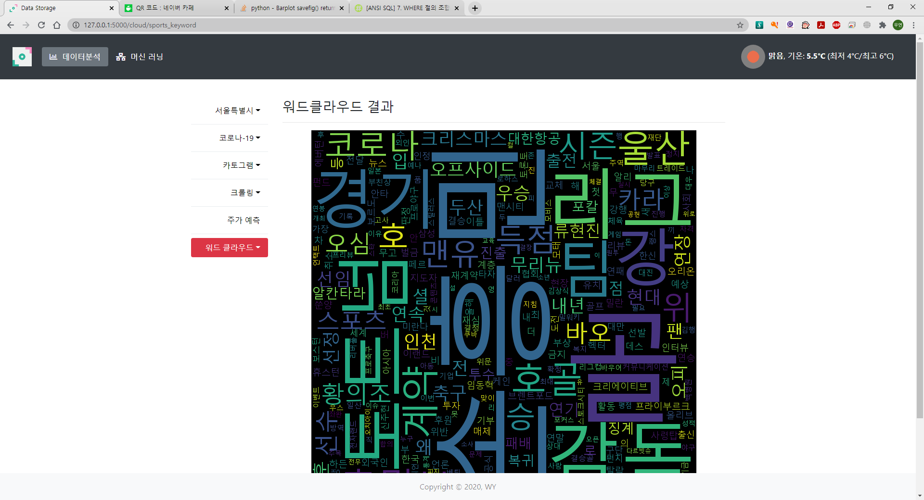
스포츠 뉴스 크롤링 후 워드클라우드

